Slide 1
Study Group
#4: CNN Intro
Speaker: Lindy Zhai, Mindy Lee
University of Toronto Machine Intelligence Team

Slide 2
What to expect?
This week’s content
Quizzes (Q&A)
General Q&A sessions
Notes:
This is the first session so we will take it easy and go through some details regarding the curriculums and what is coming next. But I can assure you the following sessions are going to be far more interesting and you can expect a lot of extra fun details that was not included in the lectures.

Slide 3
Continue;
Notes:
This is the first session so we will take it easy and go through some details regarding the curriculums and what is coming next. But I can assure you the following sessions are going to be far more interesting and you can expect a lot of extra fun details that was not included in the lectures.

Slide 4
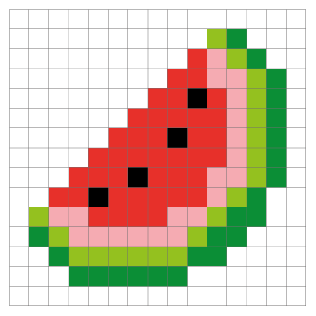
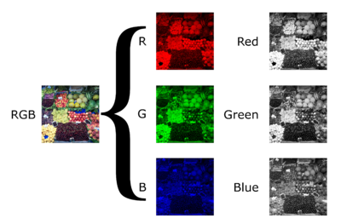
What_is_image;
pixels
Color channels
Notes:
This is the first session so we will take it easy and go through some details regarding the curriculums and what is coming next. But I can assure you the following sessions are going to be far more interesting and you can expect a lot of extra fun details that was not included in the lectures.

Slide 5
What_is_image;
I’ll show you with some python code examples.
Notes:
This is the first session so we will take it easy and go through some details regarding the curriculums and what is coming next. But I can assure you the following sessions are going to be far more interesting and you can expect a lot of extra fun details that was not included in the lectures.

Slide 6
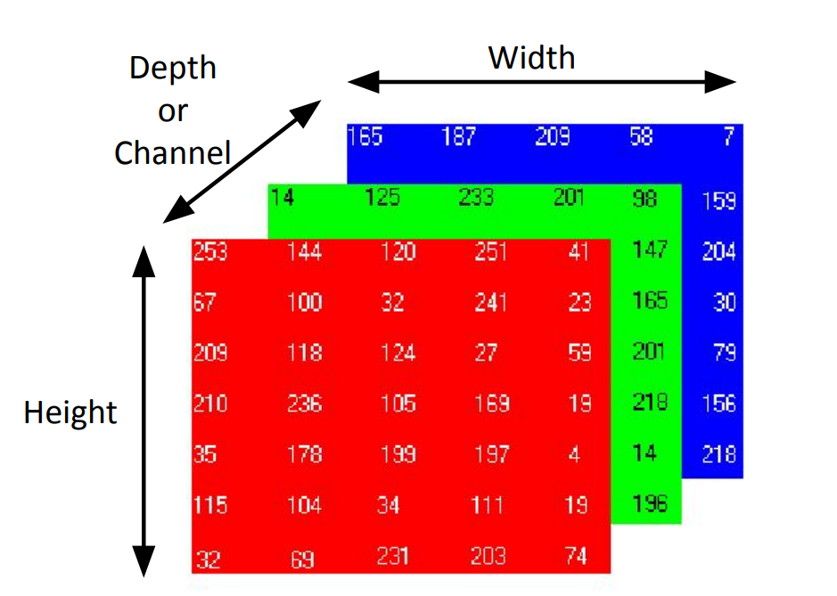
Image_Array_Difference;
Notes:
Have spatial relationship; also have multiple channels that hold different information

Slide 7
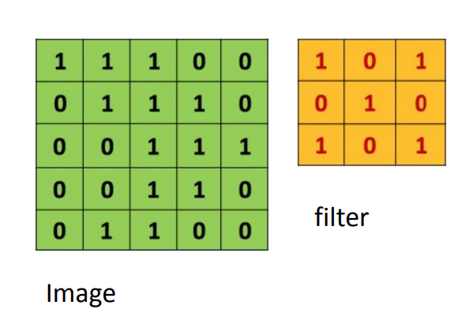
Convolutional_Operation;
Notes:
See code examples

Slide 8
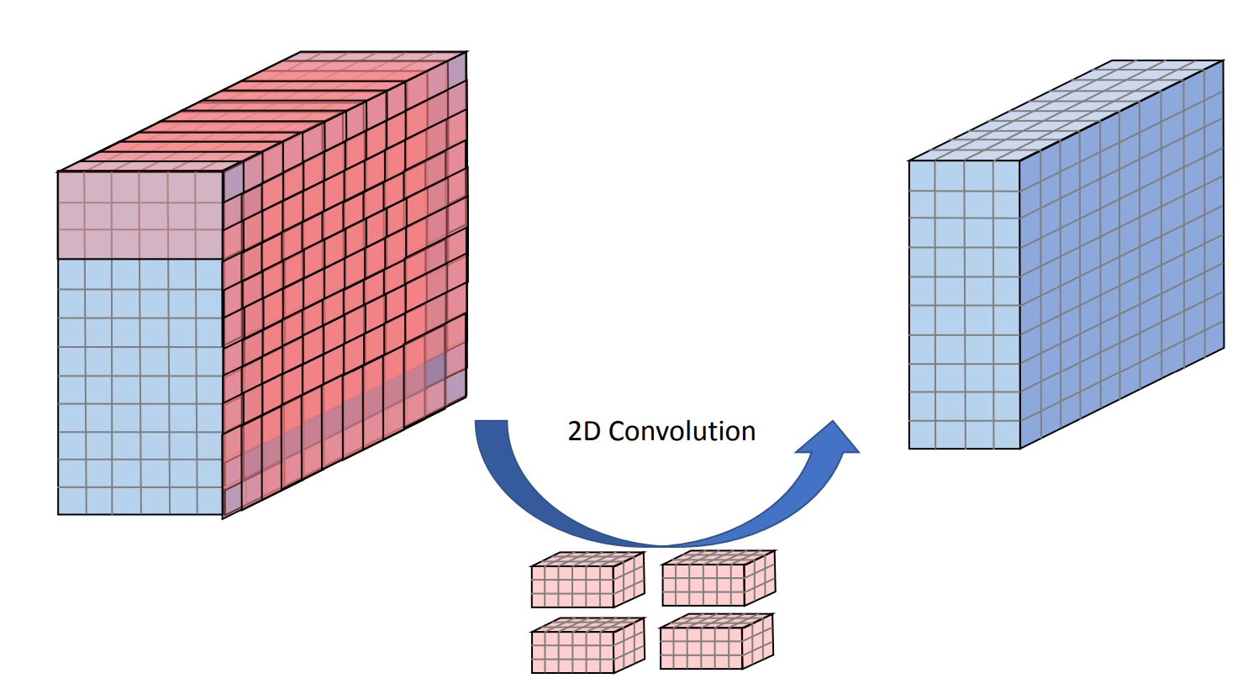
Convolutional_Operation;
Notes:
This is the first session so we will take it easy and go through some details regarding the curriculums and what is coming next. But I can assure you the following sessions are going to be far more interesting and you can expect a lot of extra fun details that was not included in the lectures.

Slide 9
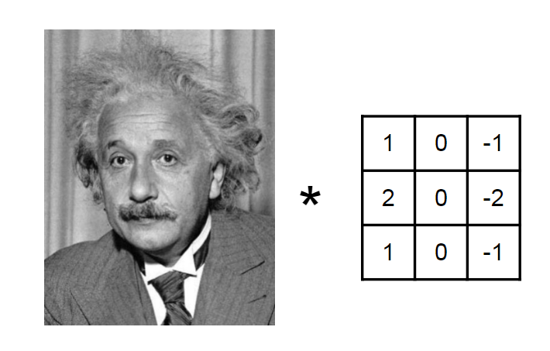
Convolutional_Operation;
Notes:
This is the first session so we will take it easy and go through some details regarding the curriculums and what is coming next. But I can assure you the following sessions are going to be far more interesting and you can expect a lot of extra fun details that was not included in the lectures.

Slide 10
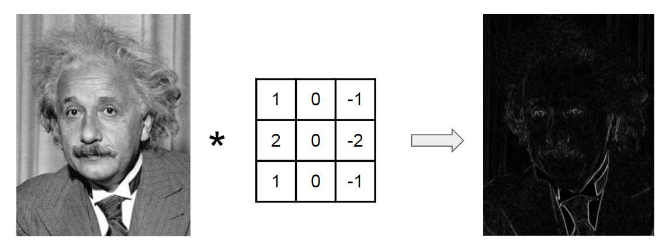
Convolutional_Operation;
Notes:
Propose a horizontal edge detector;

Slide 11
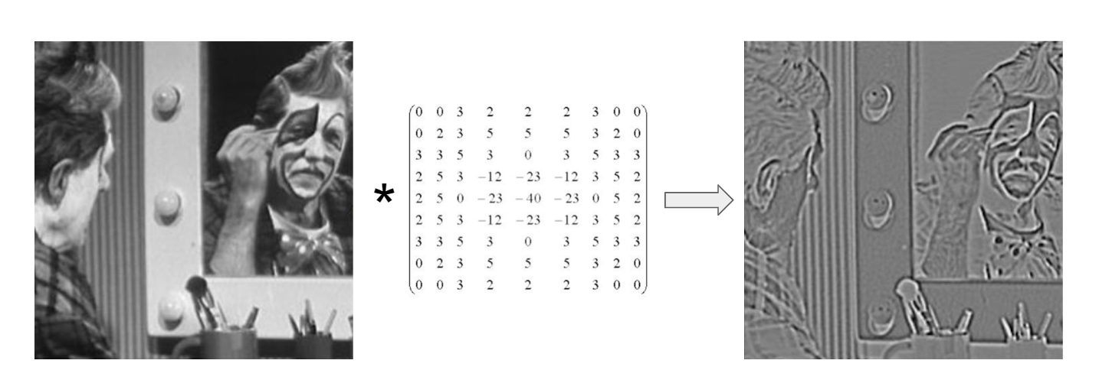
Convolutional_Operation;
Notes:
Propose a horizontal edge detector;

Slide 12
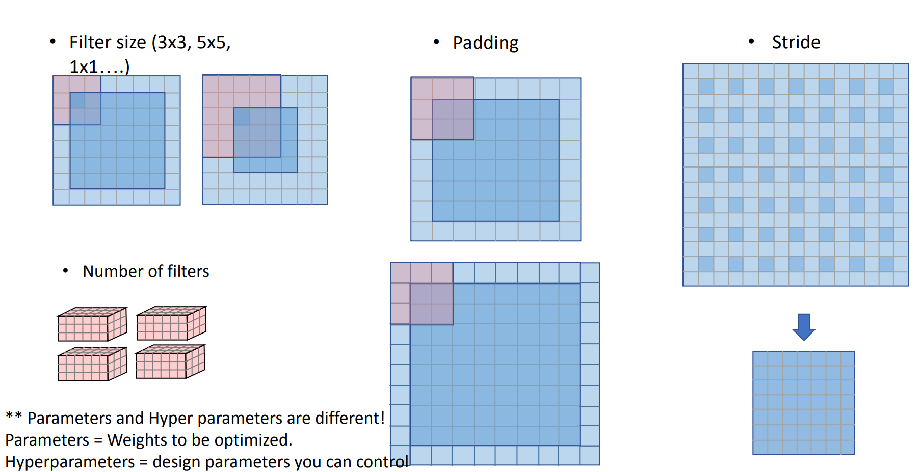
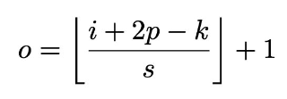
CNN_parameters;
Notes:
Propose a horizontal edge detector;

Slide 13
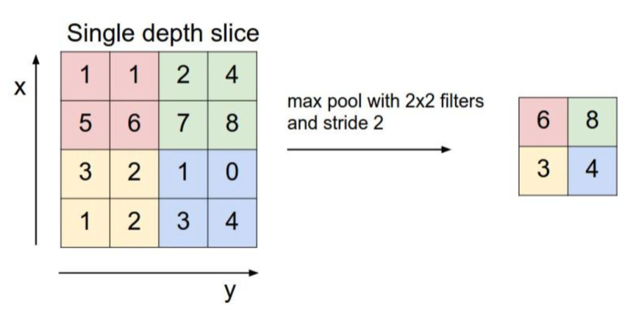
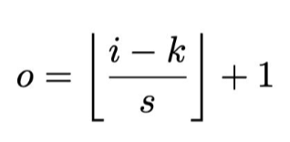
pooling;
Notes:
Propose a horizontal edge detector;

Slide 14
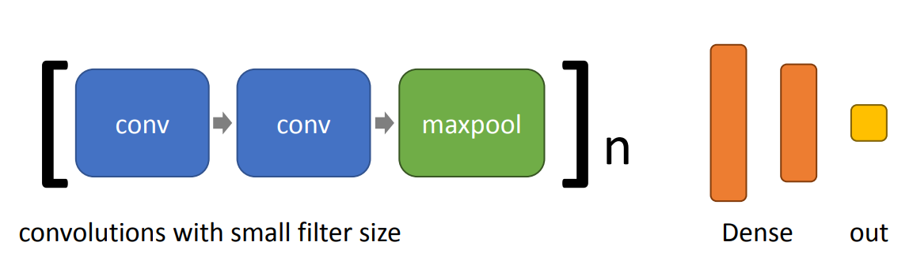
CNN_typical_structure;
Notes:
Propose a horizontal edge detector;

Slide 15
Quiz!!!!!
Notes:
This is the first session so we will take it easy and go through some details regarding the curriculums and what is coming next. But I can assure you the following sessions are going to be far more interesting and you can expect a lot of extra fun details that was not included in the lectures.

Slide 16
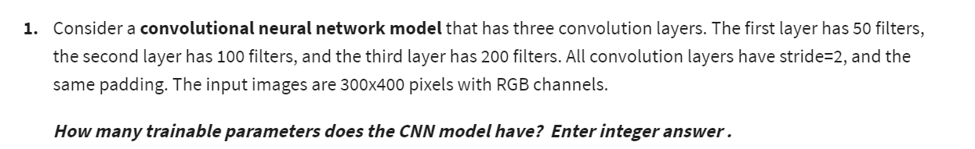
Quiz_Week_3_#1;
Notes:
This is the first session so we will take it easy and go through some details regarding the curriculums and what is coming next. But I can assure you the following sessions are going to be far more interesting and you can expect a lot of extra fun details that was not included in the lectures.

Slide 17
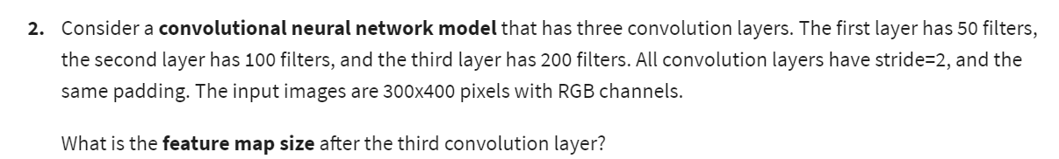
Quiz_Week_3_#1;
Notes:
This is the first session so we will take it easy and go through some details regarding the curriculums and what is coming next. But I can assure you the following sessions are going to be far more interesting and you can expect a lot of extra fun details that was not included in the lectures.

Slide 18
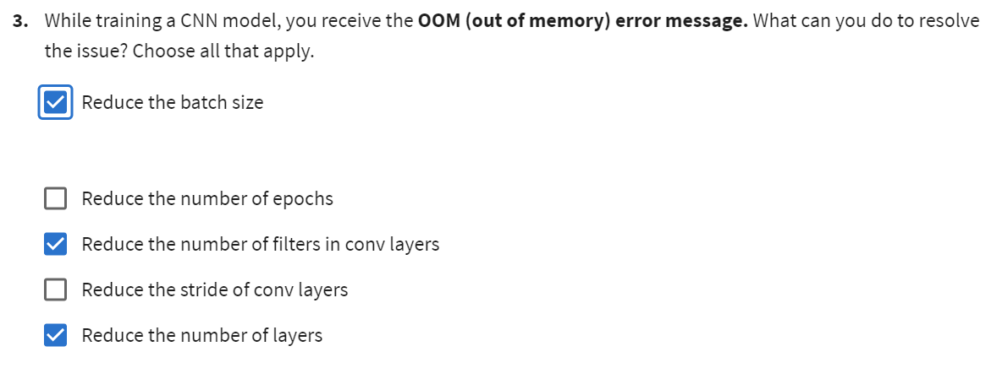
Quiz_Week_3_#1;
Notes:
This is the first session so we will take it easy and go through some details regarding the curriculums and what is coming next. But I can assure you the following sessions are going to be far more interesting and you can expect a lot of extra fun details that was not included in the lectures.

Slide 19
Quiz_Week_3_#1;
Notes:
This is the first session so we will take it easy and go through some details regarding the curriculums and what is coming next. But I can assure you the following sessions are going to be far more interesting and you can expect a lot of extra fun details that was not included in the lectures.

Slide 20
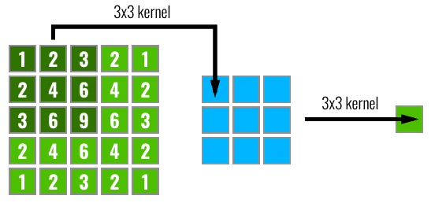
Quiz_Week_3_#1;
Notes:
This is the first session so we will take it easy and go through some details regarding the curriculums and what is coming next. But I can assure you the following sessions are going to be far more interesting and you can expect a lot of extra fun details that was not included in the lectures.

Slide 21
Next Session;
More about CNN！！！
CNN typical architectures
Transfer Learning
Notes:
This is the first session so we will take it easy and go through some details regarding the curriculums and what is coming next. But I can assure you the following sessions are going to be far more interesting and you can expect a lot of extra fun details that was not included in the lectures.

